Slide 1
BDD TESTING

Slide 2
Agenda
What is BDD?
TDD child
Pros and cons of BDD
Gherkin language
Declarative vs imperative
Lots of useful practice! ☺

Slide 3

What is bdd?
Behavior
Driven
Development
<- Dan North
Notes:
https://habr.com/post/216923/

Slide 4
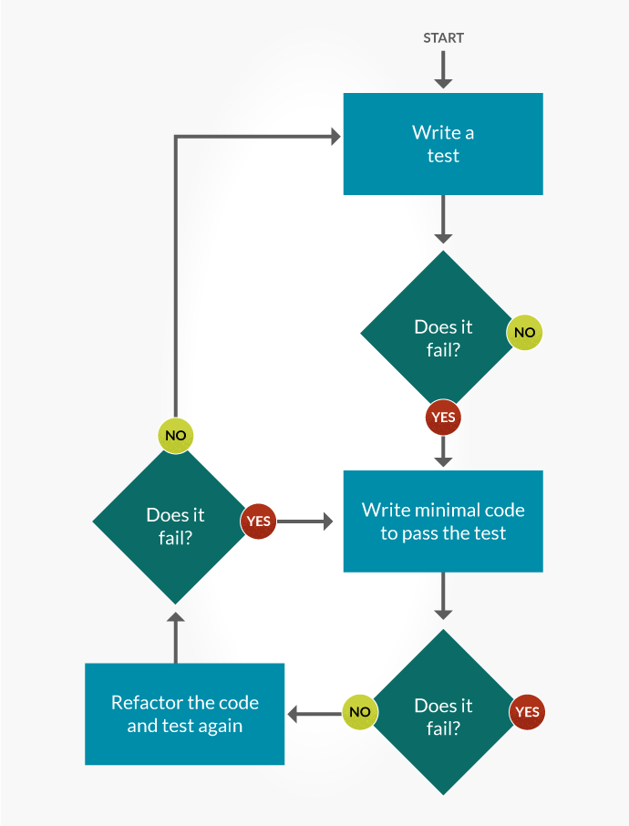
THE GREAT TDD CHILD

Slide 5
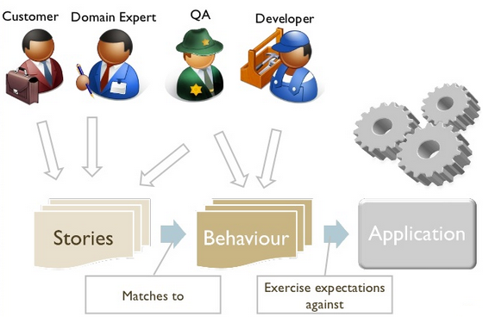
ROLES

Slide 6
IS BDD WORTH?
PROS
CONS
You’re talking in behaviors, not in tests
Faster learning
Wider audience
Team communication
All TDD pros
Incompatible with waterfall
Can’t use with unspecified requirements
Need to know TDD
Need to have good technical skills
Some of TDD cons
Notes:
Like bugs, testing ahead of time etc.

Slide 7
GHERKIN
Feature
Scenario
Scenario outline
Steps
Tables
Background
Notes:
https://wellbehaved.readthedocs.io/Gherkin.html

Slide 8
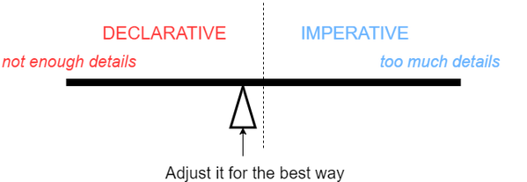
DECLARATIVE VS IMPERATIVE

Slide 9
PRACTICE TIME!
(and some questions if you have)

